Slide 1



SlideSpace
✨
Automatic slide generation with Evolutionary Layout Optimization
Supervised by : DR. Amr S. Ghoneim
June 2025
✨

Slide 2



Motivation
Professors and instructors often spend hours manually converting course materials or research papers into slide decks for lectures.
Employees and professionals must frequently turn technical documents or reports into clear, engaging presentations for stakeholders.
Manually transforming documents into clear, well-designed slides is a time-consuming process that demands both deep understanding and visual design skills

Slide 3

About the problem
The technical problem is automating the extraction, summarization, and visual structuring of multimodal content from unstructured documents into slide presentations.
01
02
Document parsing
Summarization
Extract content (text, images, etc.) from various document formats
Summarize dense text into clear, slide-ready points while preserving context
03
04
Multimodality
Layout Optimization
Handle multimodality by aligning visual elements with their related text
Optimize slide layout for clarity, balance, and visual appeal automatically

Slide 4
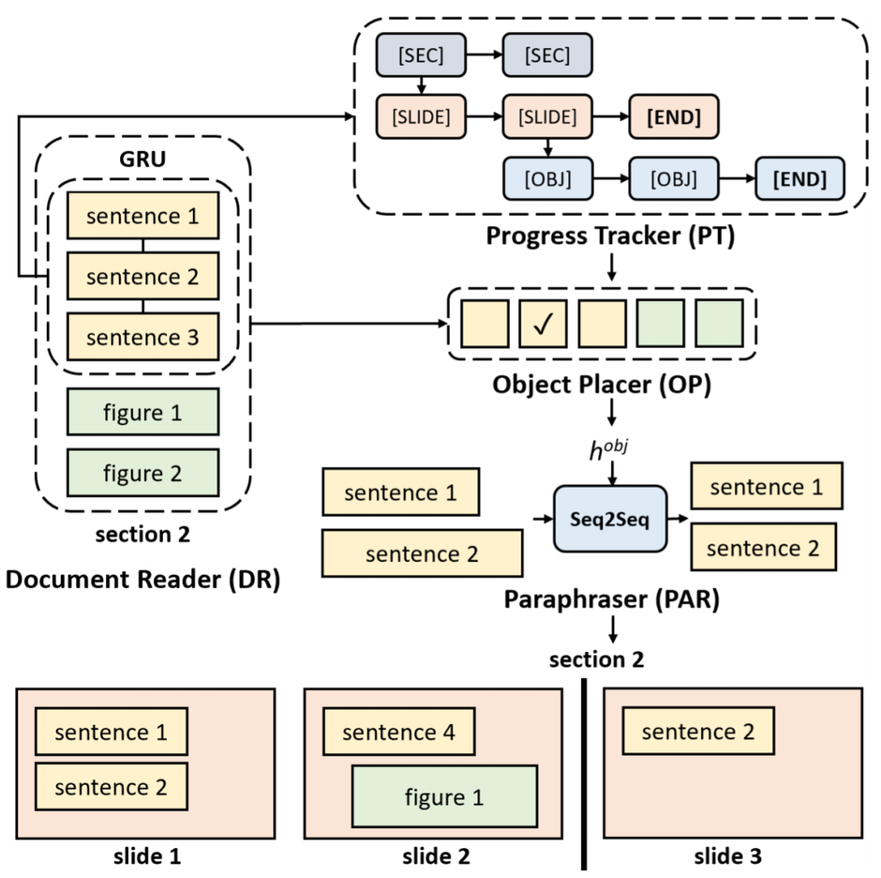
DOC2PPT approach & drawbacks
DOC2PPT (supervised) is an end-to-end model that generates slides from multimodal documents by hierarchically selecting and placing content in slides.
The dataset's focus on paper-slide pairs limits the model's generalization to non-academic documents.
The system is not truly modular tightly coupled components with shared states hinder isolation, replacement, and independent tuning.
Their extraction tools rely on deprecated dependencies with discontinued support, leading to compatibility issues and reduced long-term maintainability

Slide 5
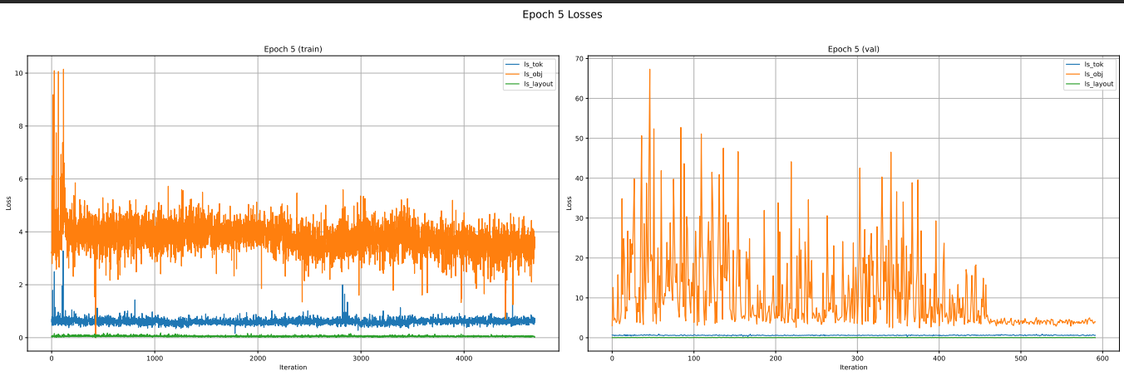
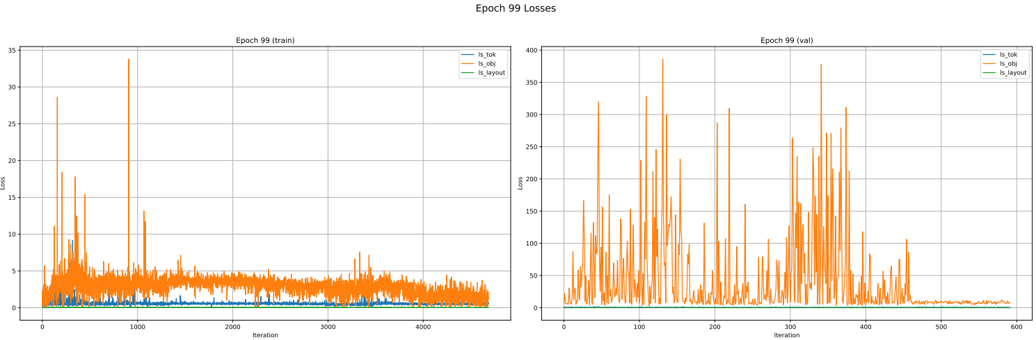
DOC2PPT approach & drawbacks
Epoch 5
Epoch 99

Slide 6
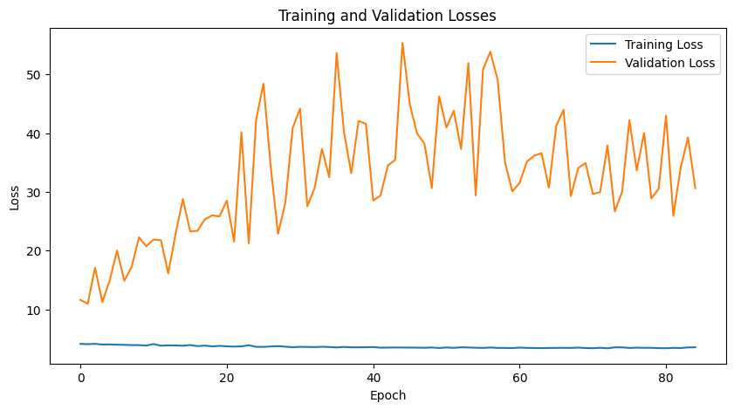
DOC2PPT approach & drawbacks
The training loss remained nearly flat, resembling a constant function, while the validation loss continuously increased suggesting the model failed to learn meaningful representations and is overfitting

Slide 7
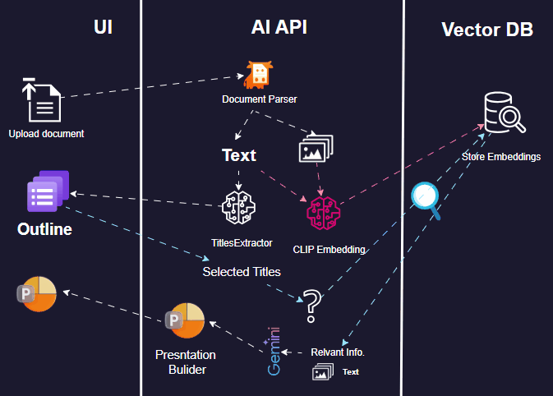
Architecture Overview
UI – Web interface for uploading documents, select titles, and exporting presentations
AI API – Summarizes and structures document content using RAG-based NLP
ELO – Optimizes slide layout using evolutionary algorithms for clarity and design

Slide 8
Document Parsing
Documents are parsed based on their format (PDF or DOCX), extracting text and images using specialized tools like PyMuPDF, pdfplumber, and python-docx
The chunking uses recursive splitting with hierarchical separators (\n\n, ., etc.,) maintaining semantic boundaries while respecting a target chunk size
Chunks include overlap to preserve context across boundaries, enabling better coherence during retrieval.
Each chunk is labeled with metadata such as page/paragraph number and position, ensuring traceability and alignment with the original document.

Slide 9
Efficient storage & retrieval
Aspect | Traditional DB (SQL / NoSQL) | Vector DB (ChromaDB, FAISS, Qdrant)
Data Type | Structured (tables, JSON, key-value, etc.) | Unstructured High-dimensional vectors (embeddings)
Query Type | Exact match, range, join, filter | Similarity search (ANN: cosine, dot product, L2)
Indexing | B-tree, hash index, inverted index | IVF, HNSW, PQ, disk-based ANN indexes
Search Goal | Retrieve records that match exact conditions | Retrieve records most similar to a given query vector
Use Case | Traditional CRUD, business data, analytics | Semantic search, recommendation, NLP, image/audio retrieval
Scalability | Scales with rows and columns | Scales with dimensions and number of vectors
Multimodal Support | No (text/image must be preprocessed externally) | Yes stores and searches image, audio, and text embeddings

Slide 10
Efficient storage & retrieval
Aspect | Flat Embedding Search | Indexed Vector Search (e.g. IVF in ChromaDB)
Search Type | Exact linear scan (brute-force) | Approximate Nearest Neighbor (ANN)
Speed | Slower as dataset grows (O(n)) | Much faster using partitioned/graph-based structures
Accuracy | High (exact distances) | Slightly lower (approximate), tunable trade-off
Indexing | No index — full scan each time | Uses structures like IVF, HNSW, PQ
Memory Usage | Simple, but scales poorly with large data | More efficient for large datasets
Use Case | Small datasets or high-precision search | Large-scale, real-time search across many vectors

Slide 11


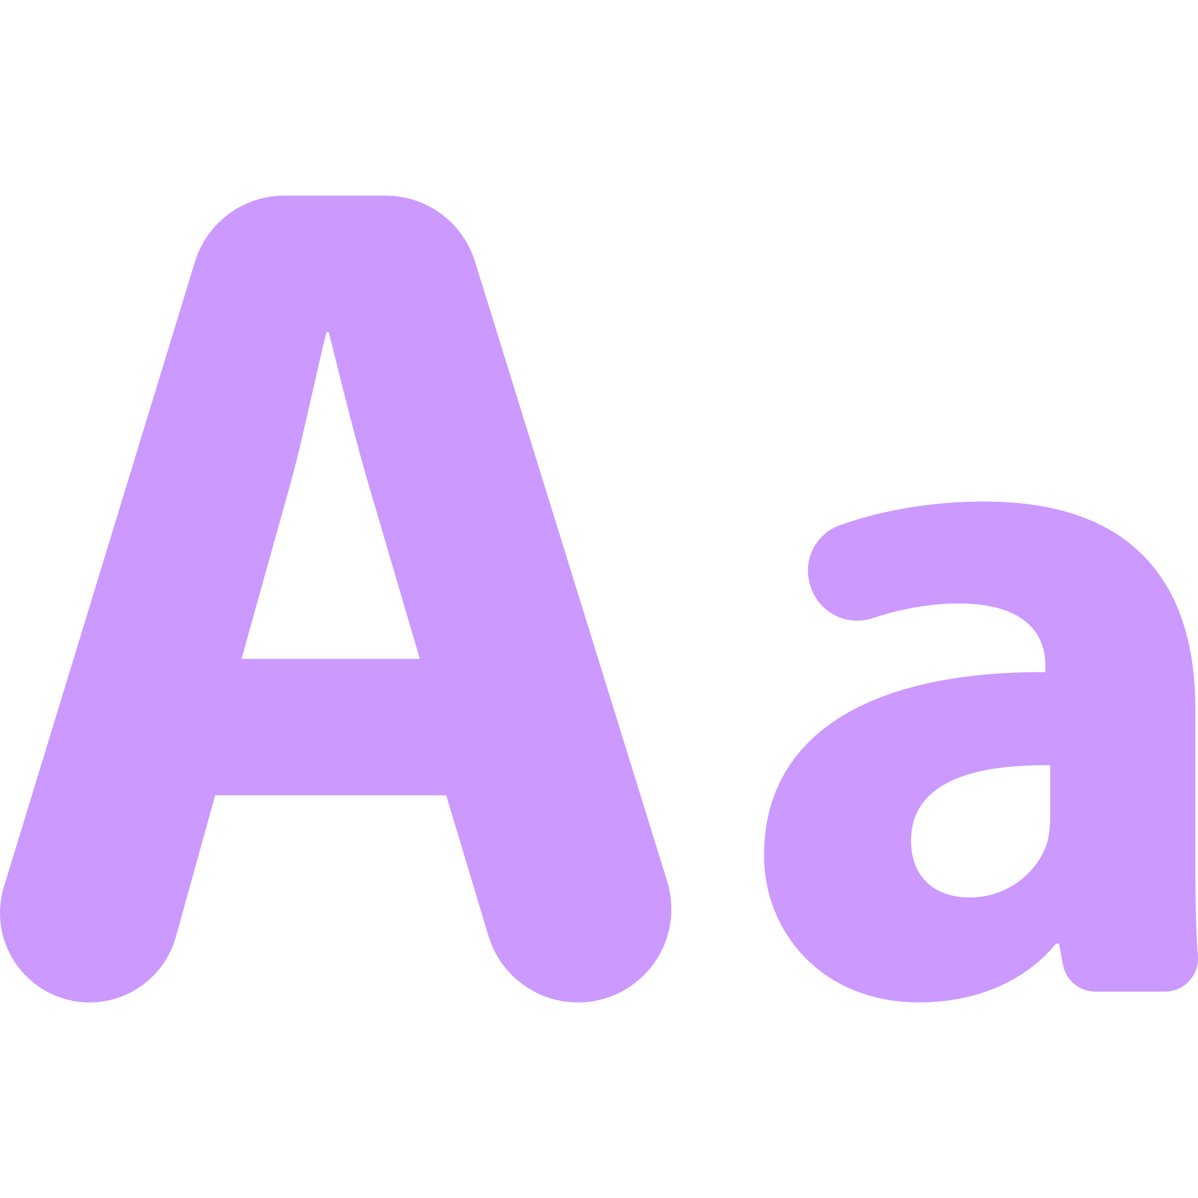
Titles as Queries !
We extract the titles from the uploaded document by one of three strategies
Font-based
Aspect | Font-Based | Semantic | Candidate
Titles | Medium | High | Low–Medium
Speed | Fast | Slow | Moderate
Precision | High (if styled) | Medium | High
Errors | Fonts inconsistent | Semantic drift | Structure-sensitive
Best for | Styled PDFs | Raw text / OCR | Semi-structured PDFs
Detect titles by identifying text with the largest font sizes in the document
Semantic
Uses text embeddings to extract diverse and informative titles from the full document
Candidate
Filters structured lines and extracts ranked keyphrases as concise, relevant titles

Slide 12
Titles as Queries !
We transform short section titles into detailed, natural language questions using a language model (e.g., Flan-T5) trained for instruction following (optional).
This reformulation adds semantic depth to vague or generic titles like “Results” or “Training,” producing context-rich queries like “How was the model trained?” or “What were the key findings?”
Using QA-style queries improves retrieval accuracy, as vector databases respond better to complete, meaningful sentences than isolated keywords.
It reduces semantic drift by making the intended focus of the query explicit, avoiding matches to unrelated text.
They also align better with answer-like document chunks, enhancing semantic similarity and content relevance.

Slide 13
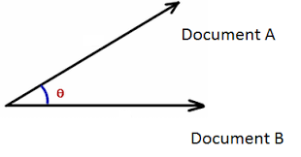
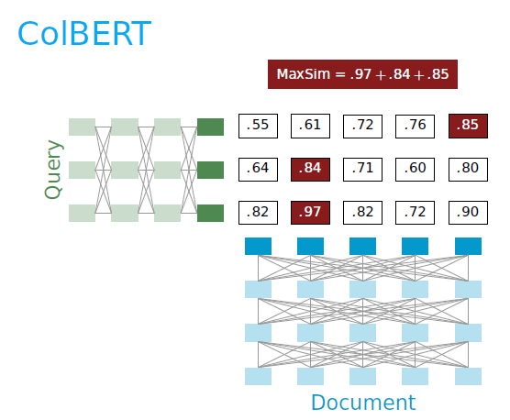
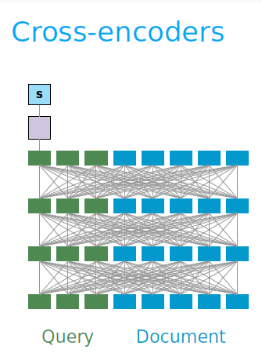
Retrieving with reranker
Cosine Similarity
ColBERT
Cross-encoder

Slide 14
Retrieving with reranker
Aspect | Cross-Encoder | ColBERT | Cosine Similarity (Bi-Encoder)
Architecture | Full interaction (query + doc jointly encoded) | Late interaction (token-level dot products) | Separate encodings (query & doc)
Speed | Slowest | Medium | Fastest
Accuracy | Highest | High | Lower
Scalability | Low | Moderate | High
Latency | High (per pair processing) | Medium (token matching cost) | Low (instant vector search)

Slide 15

Summarization with RAG
BART-large
Prompt-based
Task-based
Text is summarized into concise bullet points using either Google Gemini or a Hugging Face model (BART-large-cnn)
Gemini is used as the primary backend, selected for its strong language modeling and ability to follow custom prompts
Zero shot
Few shots
Chain of Thoughts
Directly asks the model to summarize without examples
Provides examples of input-output pairs to guide the model
Guides the model to reason through key ideas before summarizing
If Gemini fails or is unavailable, the system falls back to a local Hugging Face model, ensuring robust summarization even offline.

Slide 16
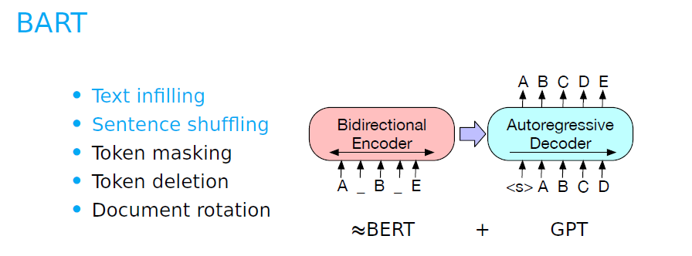
Why is BART a good candidate for this task?
BART can be useful in cases where data extraction is weak, as it is capable of filling in missing words and reconstructing context

Slide 17

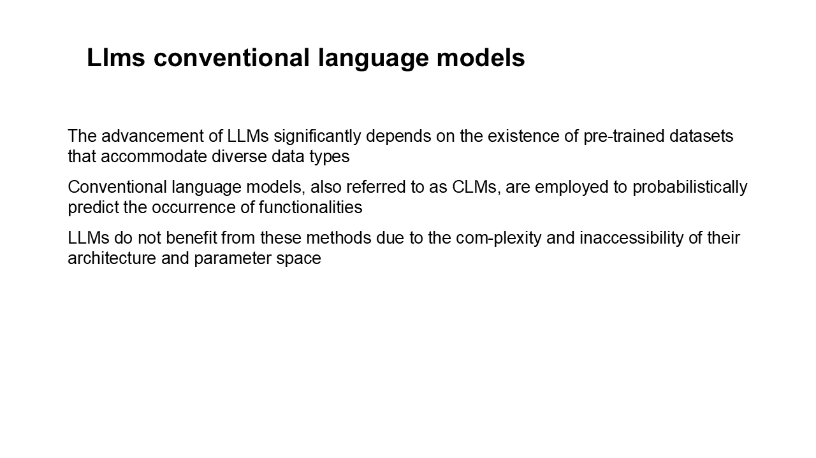
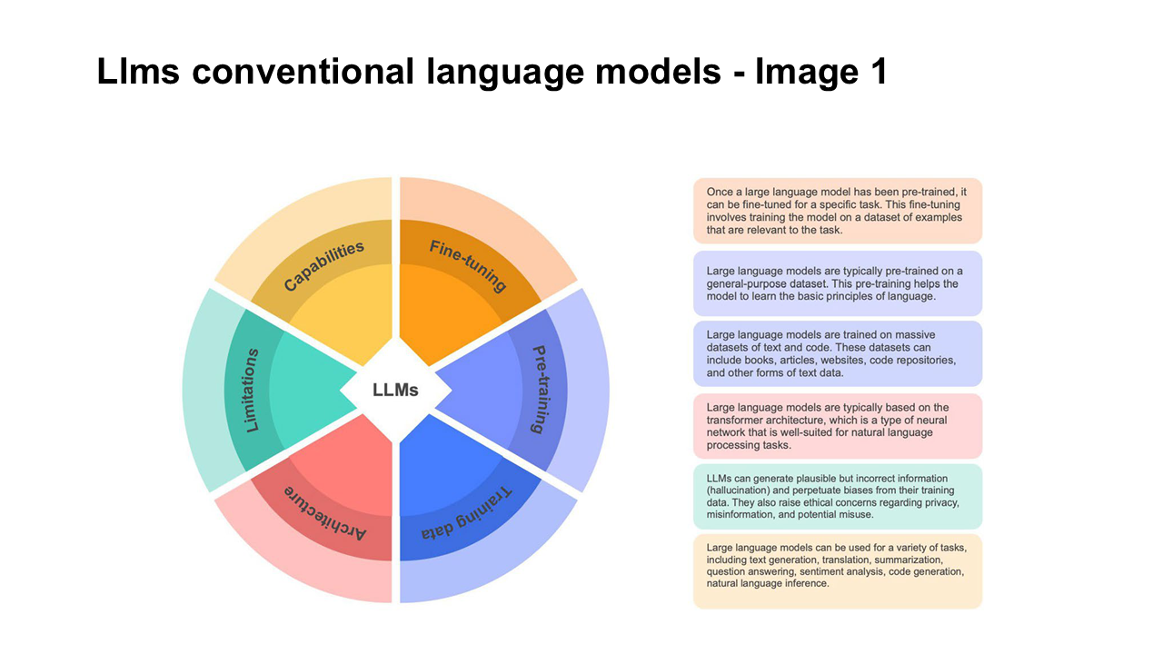
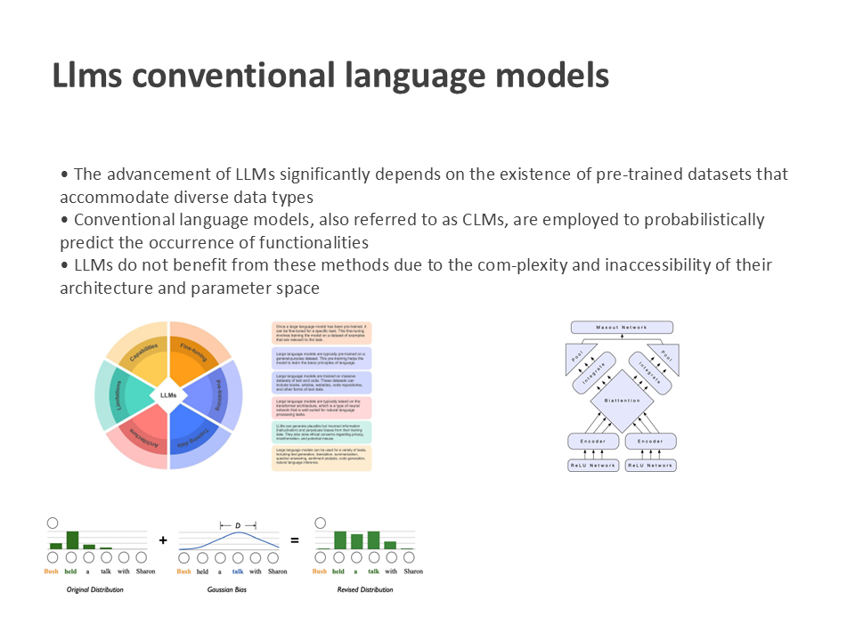
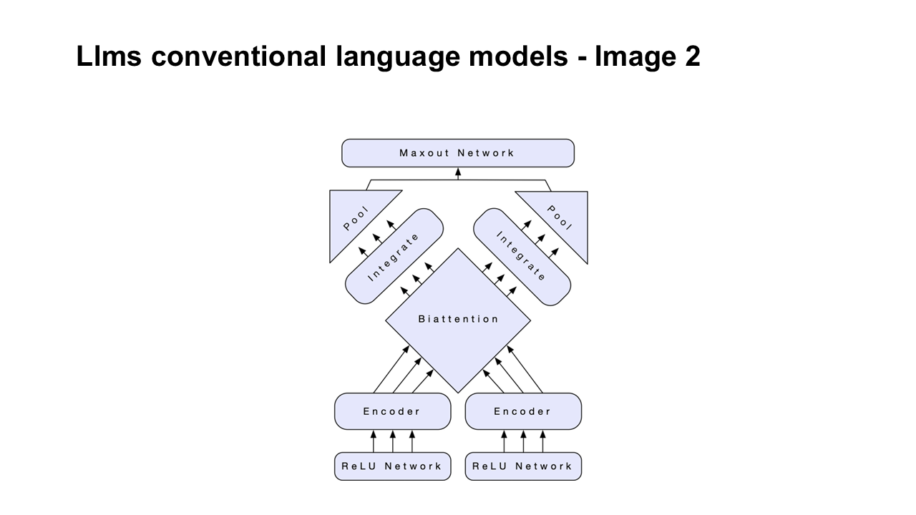
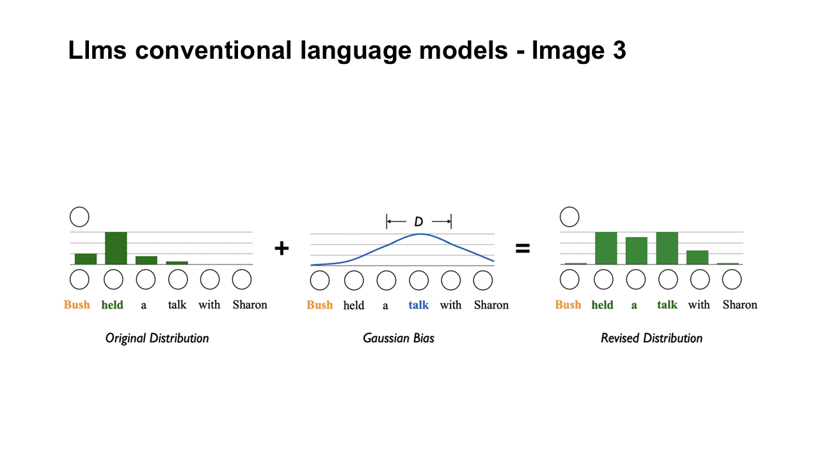
Evolutionary Layout Optimization (ELO)
ELO optimizes PowerPoint slide layouts from predefined content, maximizing presentation quality on readability, hierarchy, image integration, contrast, balance, and constraints.
Before
After

Slide 18
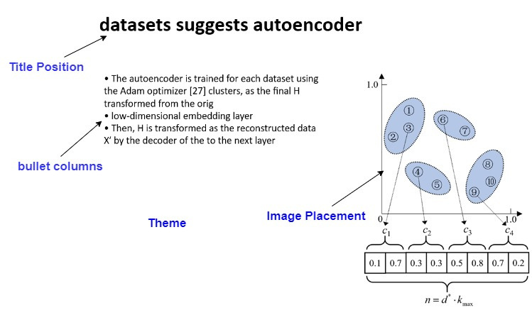


Presentation Phenotype/Genotype
Phenotype
Genotype
TOP
1
16
Right
…
Title
position
Bullet
column
Image position
Font size
Each slide’s layout is represented as a set of discrete variables called “genes” encoding design choices

Slide 19
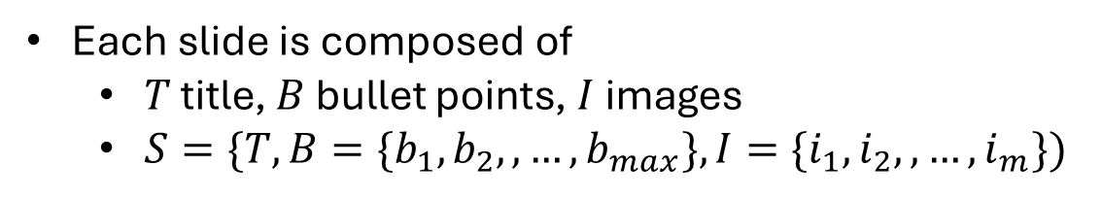
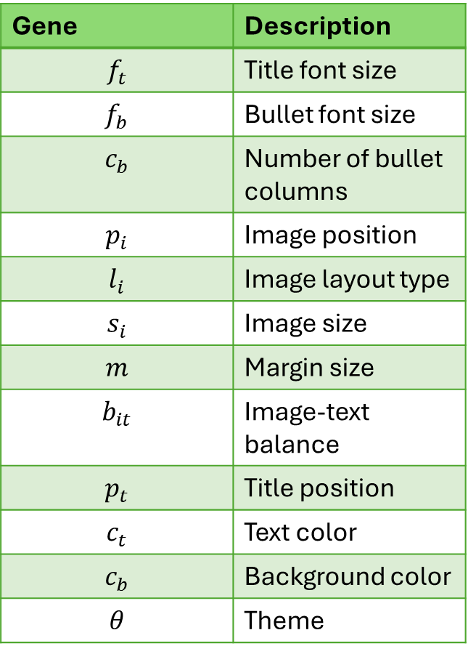
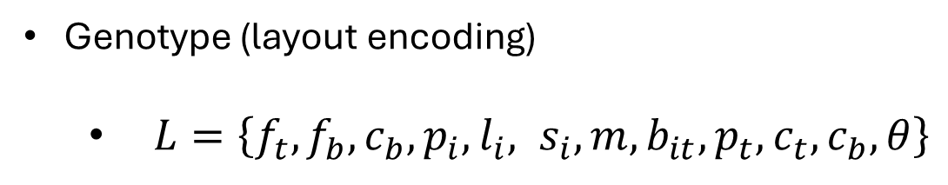
Mathematical formulation
Gene | Description
$$f_{t}$$ | Title font size
$$f_{b}$$ | Bullet font size
$$c_{b}$$ | Number of bullet columns
$$p_{i}$$ | Image position
$$l_{i}$$ | Image layout type
$$s_{i}$$ | Image size
$$m$$ | Margin size
$$b_{it}$$ | Image-text balance
$$p_{t}$$ | Title position
$$c_{t}$$ | Text color
$$c_{b}$$ | Background color
$$θ$$ | Theme
Each slide is composed of
$T$ title, $B$ bullet points, $I$ images
$S=\{T, B=\{b_{1},b_{2},,…, b_{max}\},I=\{i_{1},i_{2},,…, i_{m}\})$
Genotype (layout encoding)
$L=\left\{f_{t}, f_{b},c_{b},p_{i},l_{i}, s_{i},m, b_{it},p_{t}, c_{t},c_{b}, θ\right\}$

Slide 20
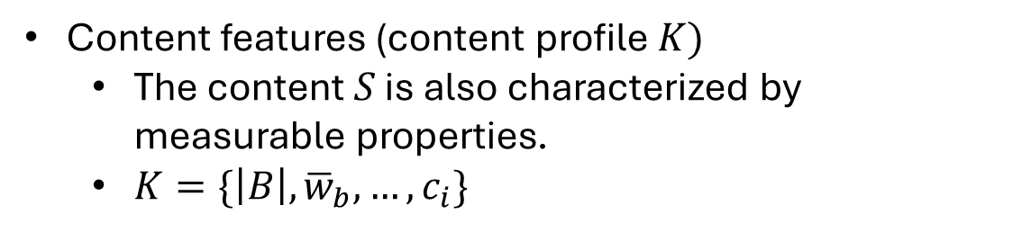
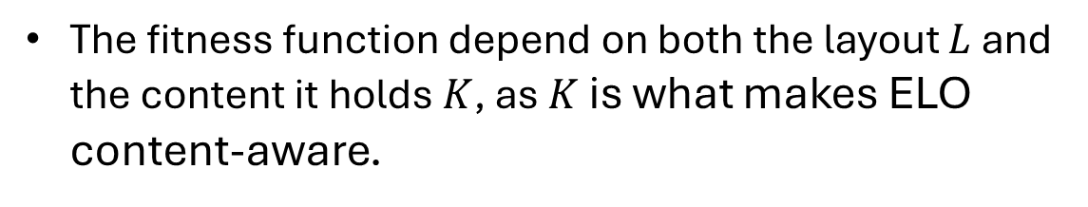
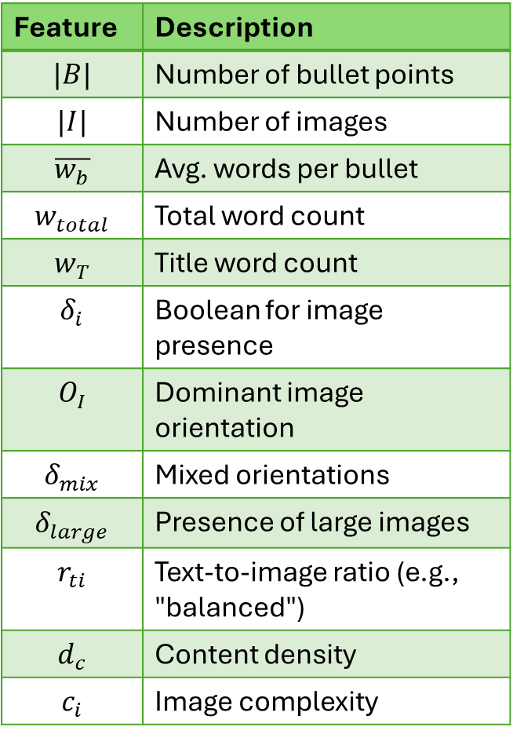
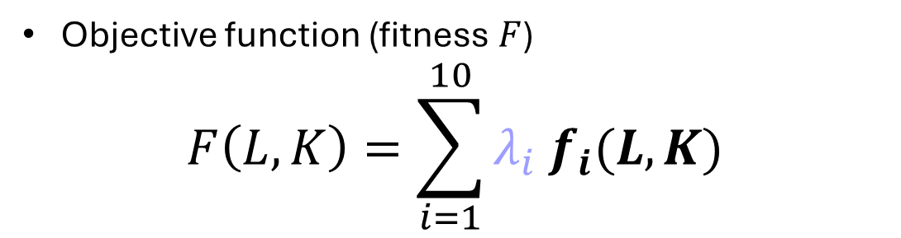
Mathematical formulation
Content features (content profile $K)$
The content $S$ is also characterized by measurable properties.
$K=\{\left|B\right|, {\overline{w}}_{b}, …,c_{i}\}$
Feature | Description
$$|B|$$ | Number of bullet points
$$|I|$$ | Number of images
$$\overline{w_{b}}$$ | Avg. words per bullet
$$w_{total}$$ | Total word count
$$w_{T}$$ | Title word count
$$δ_{i}$$ | Boolean for image presence
$$O_{I}$$ | Dominant image orientation
$$δ_{mix}$$ | Mixed orientations
$$δ_{large}$$ | Presence of large images
$$r_{ti}$$ | Text-to-image ratio (e.g., "balanced")
$$d_{c}$$ | Content density
$$c_{i}$$ | Image complexity
Objective function (fitness $F$)
$$F\left(L, K\right)=\sum_{i=1}^{10}{λ_{i} f_{i}(L,K)}$$
$λ_{i} ∈[0,1]$ is a tunable weight for each component
The fitness function depend on both the layout $L$ and the content it holds $K$, as $K$ is what makes ELO content-aware.

Slide 21

Mathematical formulation
$K$ allows the layout optimizer to adapt the design of each slide to match its content.
A slide with many bullet points needs more space or multiple columns
A slide with large images must allocate enough room without crowding text
A slide with no images shouldn’t waste space with empty placeholders
$K$ ensures that layout quality is not judged in isolation but based on how well the layout fits the actual content on the slide.
Including $K$ help the system avoids overfitting to fixed layout heuristic
Evolutionary operators (e.g., mutation) can be smarter when they know the slide contains dense text or multiple visuals — allowing for adaptive evolution.

Slide 22
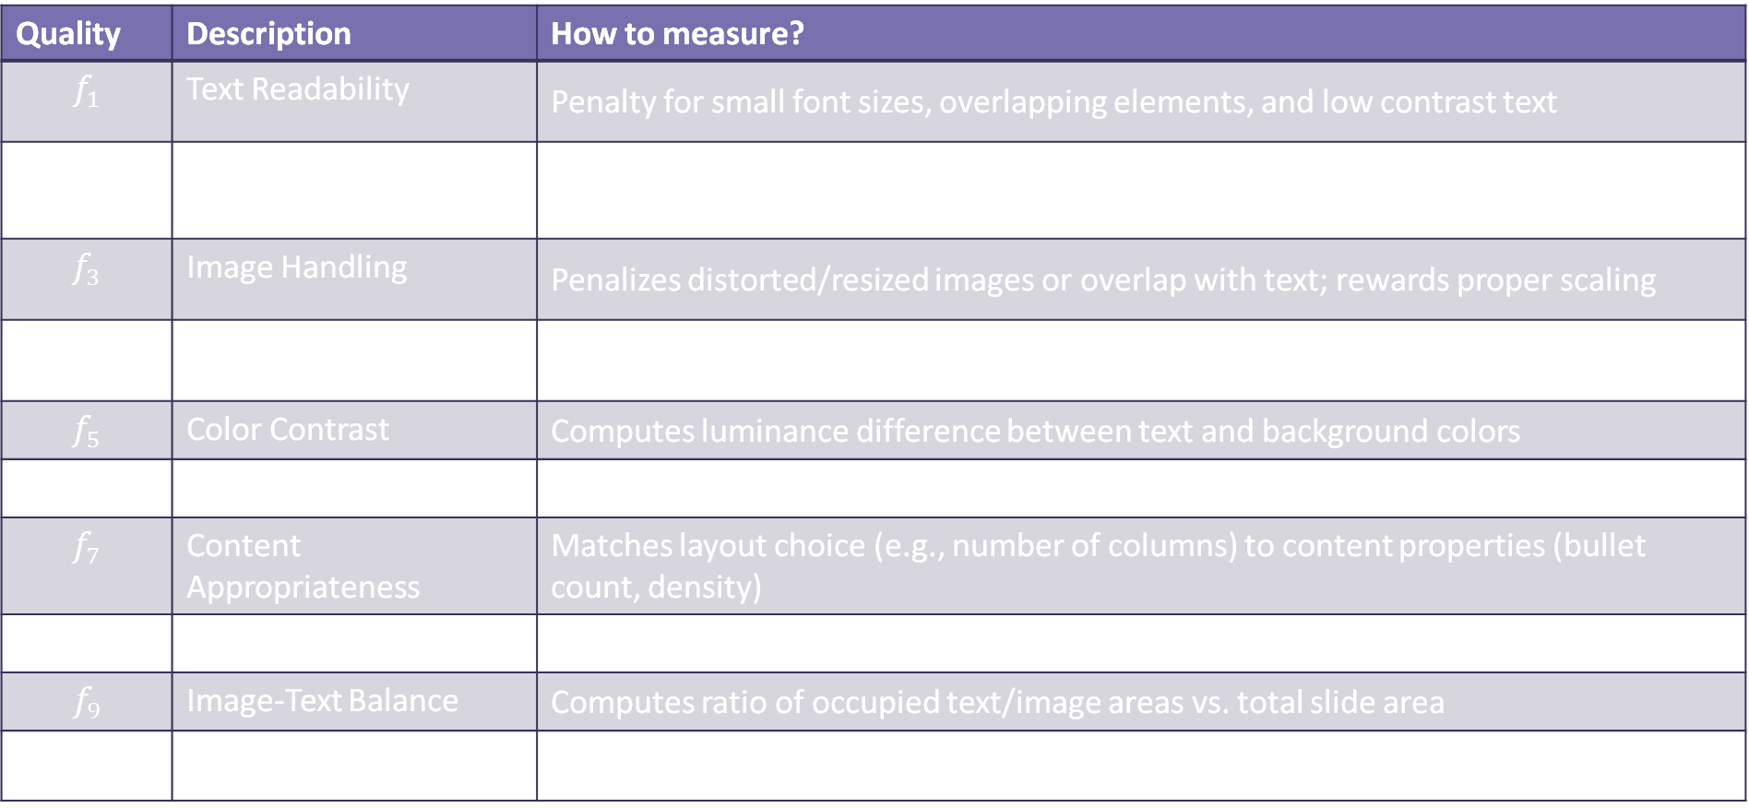
Mathematical formulation
Quality | Description | How to measure?
$$f_{1}$$ | Text Readability | Penalty for small font sizes, overlapping elements, and low contrast text
$$f_{2}$$ | Bullet Management | Evaluates column count, spacing, and bullet alignment based on number/length of bullets
$$f_{3}$$ | Image Handling | Penalizes distorted/resized images or overlap with text; rewards proper scaling
$$f_{4}$$ | Visual Balance | Compares horizontal and vertical distribution of content regions (centroid analysis)
$$f_{5}$$ | Color Contrast | Computes luminance difference between text and background colors
$$f_{6}$$ | Consistency | Checks font sizes, alignment, and color consistency with theme settings
$$f_{7}$$ | Content Appropriateness | Matches layout choice (e.g., number of columns) to content properties (bullet count, density)
$$f_{8}$$ | Accessibility | Penalizes low-contrast text, small fonts, or crowded content
$$f_{9}$$ | Image-Text Balance | Computes ratio of occupied text/image areas vs. total slide area
$$f_{10}$$ | Boundary Constraints | Applies hard penalties for content outside margins or overlapping bounding boxes

Slide 23
Evolutionary operators
TOP
1
36
Left
Blue
…
TOP
1
36
Left
Blue
…
Parent 1
Parent 2
Center
2
16
Right
White
…
Child
TOP
2
16
Right
Blue
…
TOP
1
20
Left
Blue
…
Uniform crossover
Flip mutation

Slide 24
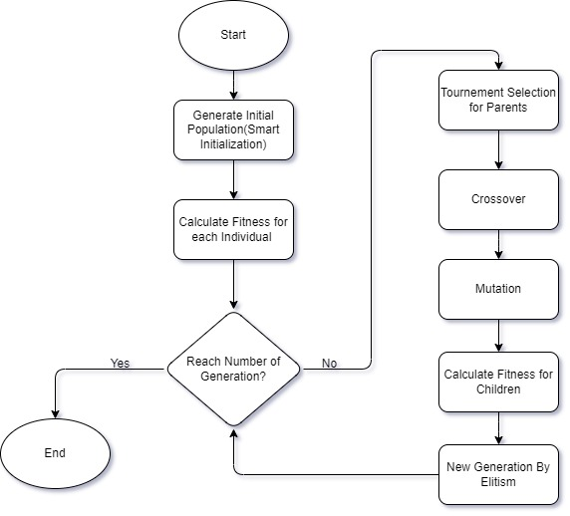
GA for ELO
Simple rules or brute-force can't cope with the layout search space—too large, too complex
Genetic Algorithm (GA) is ideal because:
It searches globally and efficiently in high-dimensional, discrete spaces.
It maintains diversity, reducing the risk of getting stuck in local optima.
It adapts well to multi-objective layout criteria (fitness function).
Empirically proven for layout and design problems.

Slide 25
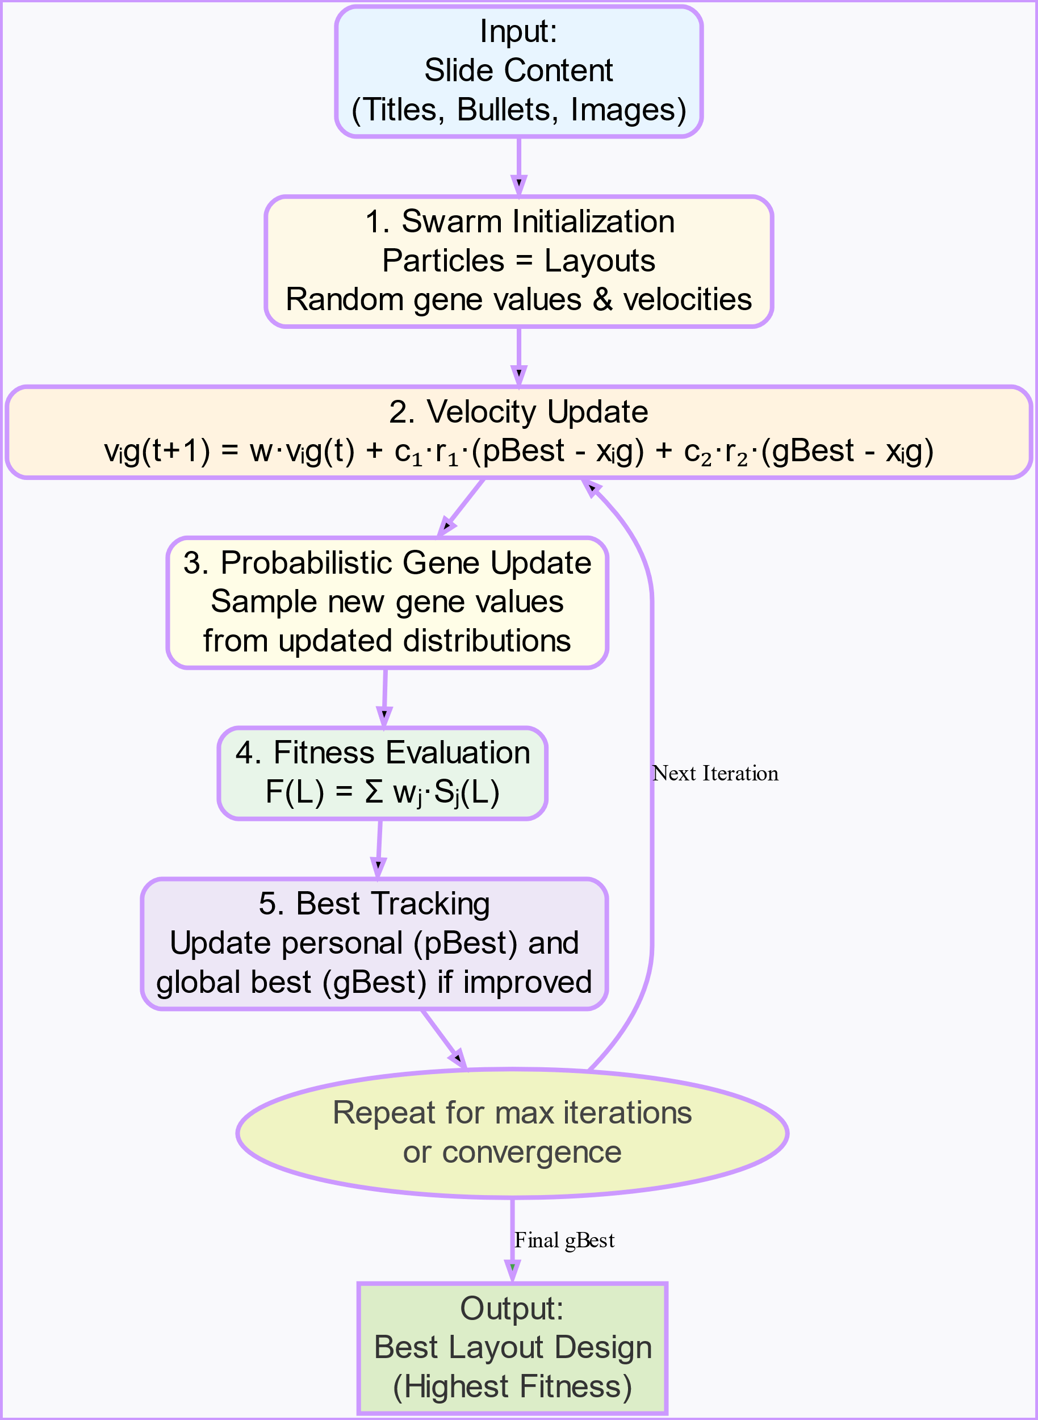
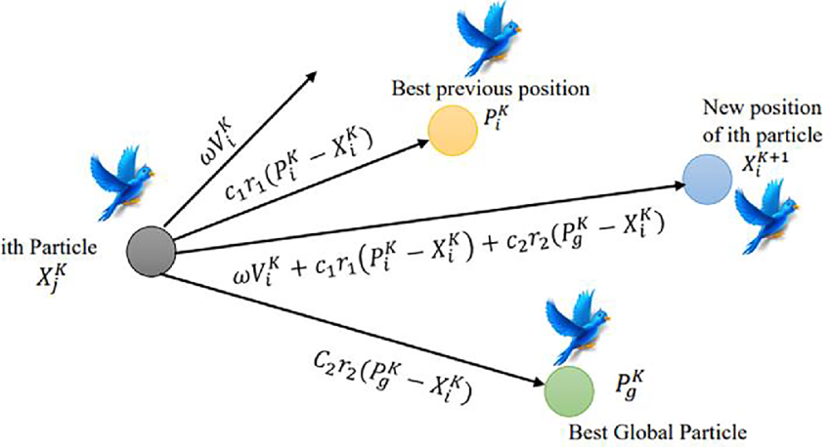
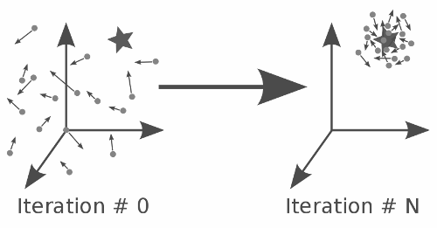
PSO for ELO
PSO models a “swarm” of particles exploring layout space, inspired by birds flocking towards food.
Each particle represents a possible slide layout.
Particles share information:
They move in the direction of their own best found solution (personal best)
They are also pulled toward the global best solution found by the swarm.
Layout updating in discrete design:
Each gene (e.g., title position, image layout) is updated based on a probability distribution, influenced by local/global bests.

Slide 26
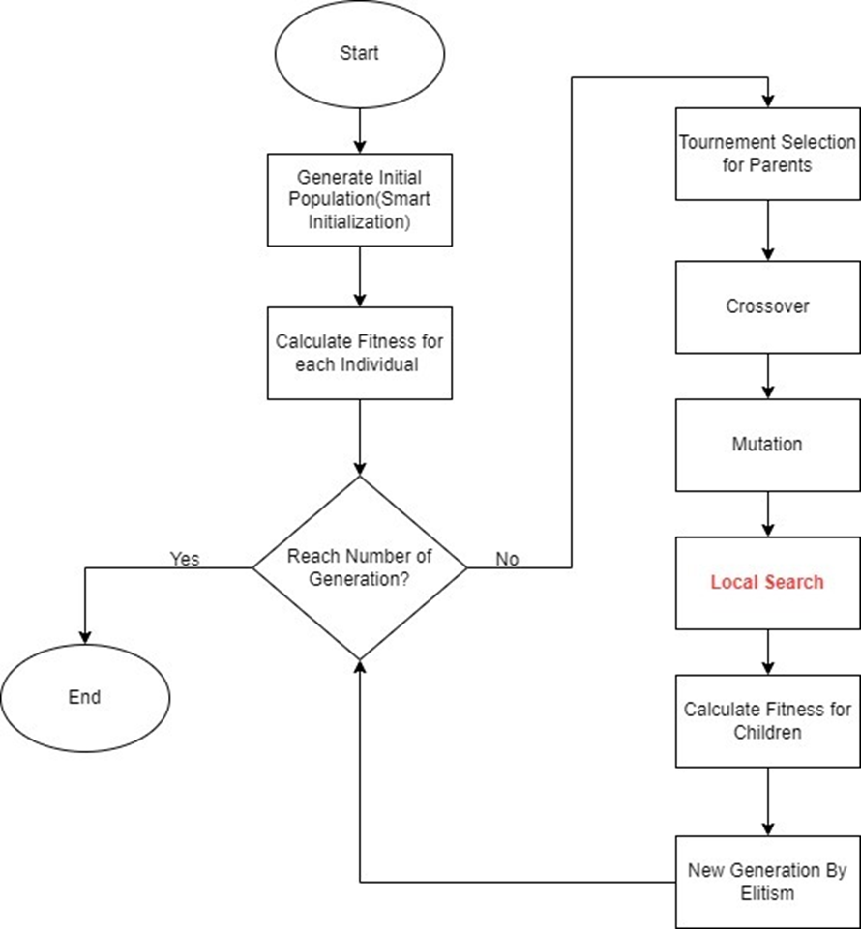
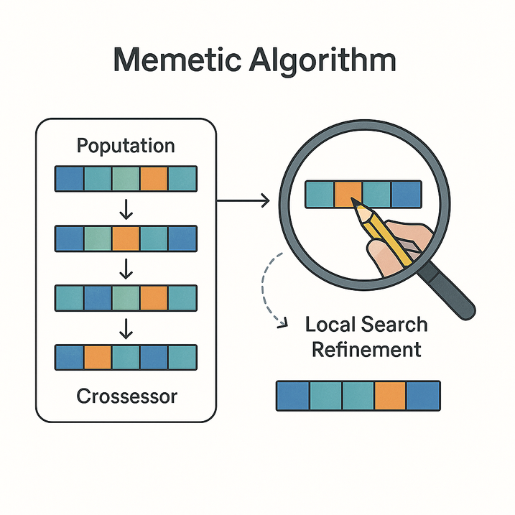
Memetic for ELO
Memetic Algorithm combines global search (like GA) with local search for extra refinement:
Population evolves through selection, crossover, and mutation (as in GA).
After each generation, select layouts undergo “local search” (hill climbing), trying small gene tweaks to further increase fitness.

Slide 27
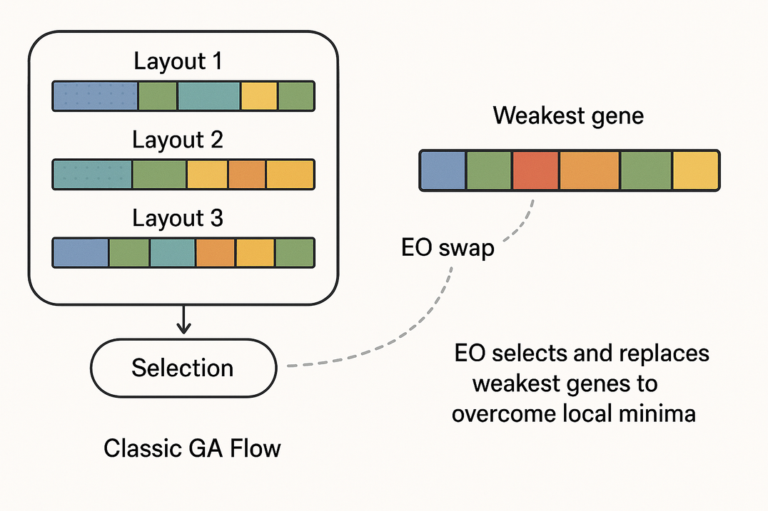
Hybrid EO-GA for ELO
Hybrid EO-GA alternates standard GA evolution with τ-Extremal Optimization (EO):
GA phase explores broadly, combining and mutating layouts as usual.
EO phase targets the worst-performing genes (“weakest links”) in top layouts, probabilistically replacing them to break out of local optima.
Uses a heavy-tailed probability distribution controlled by parameter τ.

Slide 28
Evaluation
Rank | Algorithm | Fitness Score | Time (s) | Convergence | Stability | Overall Score
1 2 3 4 | Memetic GA PSO Hybrid GA-EO | 176.80±97.38 178.60±94.34 172.33±101.33 175.00±100.29 | 1.32±0.49 0.35±0.09 0.70±0.3 11.18±1.89 | 0.844 0.500 0.794 0.500 | 0.850 0.750 0.926 0.800 | 0.882 0.821 0.810 0.658
The table shows that GA achieves the highest average fitness and fastest runtime, consistently outperforming other methods in solution quality and efficiency, making it the most effective choice for slide layout optimization.

Slide 29
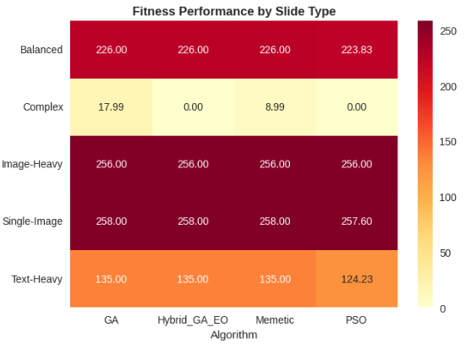
Performance Analysis by Slide Type
GA, Hybrid GA-EO, and Memetic all achieved a fitness score of 135.00 across all slide types.
GA achieved the fastest runtime at 0.270s
On complex, high-density slides, GA scored a modest 17.99 with significant result variation.

Slide 30
Evaluation
Metric Name | Purpose | Model / Method | Output Score
ROUGE-1 | Unigram (word-level) overlap | N-gram F1-measure | [0, 1]
ROUGE-2 | Bigram overlap | N-gram F1-measure | [0, 1]
ROUGE-3 | Trigram overlap | N-gram F1-measure | [0, 1]
ROUGE-4 | Four-gram overlap | N-gram F1-measure | [0, 1]
ROUGE-L | Longest common subsequence | LCS F1-measure | [0, 1]
ROUGE-S | Skip-bigram overlap | Skip-bigram F1-measure | [0, 1]
ROUGE-SL | ROUGE-L with length normalization | Adapted ROUGE-L formula | [0, 1]
G-Eval (LLM, Gemini) | LLM-based human-aligned judgmen | Gemini LLM (Google) | 1–5 (per dimension)
G-Eval (LLM, Llama) | LLM-based human-aligned judgment | Llama-2 LLM (Meta) | 1–5 (per dimension)
Text-Figure Relevance | Multimodal slide text/image alignment | CLIP similarity | [0, 1]
BERTScore | Contextual semantic similarity | Transformer (BERT/RoBERTa) | [0, 1]
BLEURT | Learned quality metric, human-aligned | Fine-tuned BERT on ratings | [-1, 1]
We use ROUGE-1 to ROUGE-4, ROUGE-L, and ROUGE-S to measure similarity to reference summaries
We use LLM-based metrics (e.g., G-Eval via Gemini and LLaMA-2) to score summaries on coherence , relevance, and fluency
We use BERTScore for semantic similarity and CLIP for text-image alignment to assess language and visual relevance

Slide 31
Evaluation
Metric | Score (Average over all PDFs/slides)
ROUGE-1 (F1) | 0.08966
ROUGE-2 (F1) | 0.013567
ROUGE-3 (F1) | 0.00107
ROUGE-4 (F1) | 0.000267
ROUGE-L (F1) | 0.05533
ROUGE-S (F1) | 0.0034
ROUGE-SL (F1) | 0.0125
G-Eval (Gemini) | - Coherence: 3.55 - Consistency: 2.50 - Fluency: 4.47 - Relevance: 2.86
G-Eval (Llama) | - Coherence: 3.71 - Consistency: 3.31 - Fluency: 3.82 - Relevance: 3.70
Text-Figure Relevance | 0.2278
BERTScore (F1) | 0.5180
BLEURT | 0.2787
Low ROUGE scores (e.g., ROUGE-1: 0.089, ROUGE-2: 0.013) indicate minimal word overlap with reference texts.
G-Eval (Gemini) excelled in fluency but showed uneven scores across other aspects.
while G-Eval (LLaMA) delivered more balanced results, indicating better overall alignment with human judgment.
BERTScore achieved the highest score (0.5180), reflecting strong semantic similarity with reference content.

Slide 32


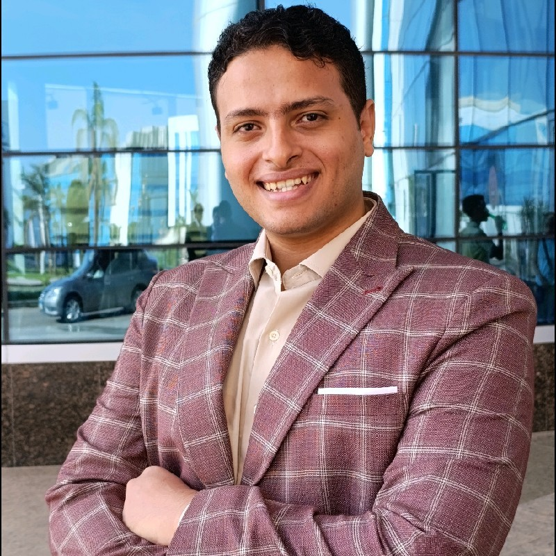



TEAM
Ahmed M. Makboul
Ahmed Mostafa
Hossam Ahmed
Omar Ayman
Ahmed Bassiouny
Ahmed Ismail

Slide 33


Thanks

